Slide 1

Stock Market Prediction
Using machine learning
Submitted by:
Aditya Rana(20BCS5643)

Slide 2
Introduction
1. A stock market is a public market where you can buy and sell shares for publicly listed companies.
2. Stock Market prediction refers to understanding various aspects of the stock market that can influence the price of a stock and, based on these potential factors, build a model to predict the stock’s price.
3. There are other factors involved in the prediction, such as physical and psychological factors, rational and irrational behavior, and so on
4. The stock market is known for being volatile, dynamic, and nonlinear.

Slide 3
Objective
The objective is to predict the stock prices in order to make more informed and accurate investment decisions
Stock market prediction is the act of trying to determine the future value of a company stock or other financial instrument traded on an exchange.
The project aims at applying machine learning LSTM, for finding the stock market analysis

Slide 4
Technology used
Visual studio code: Visual Studio Code combines the simplicity of a source code editor with powerful developer tooling, like IntelliSense code completion and debugging.
Streamlit: Streamlit is an open source app framework in Python language. It helps us create web apps for data science and machine learning in a short time
Python: Python is an interpreted, object-oriented, high-level programming language with dynamic semantics.

Slide 5
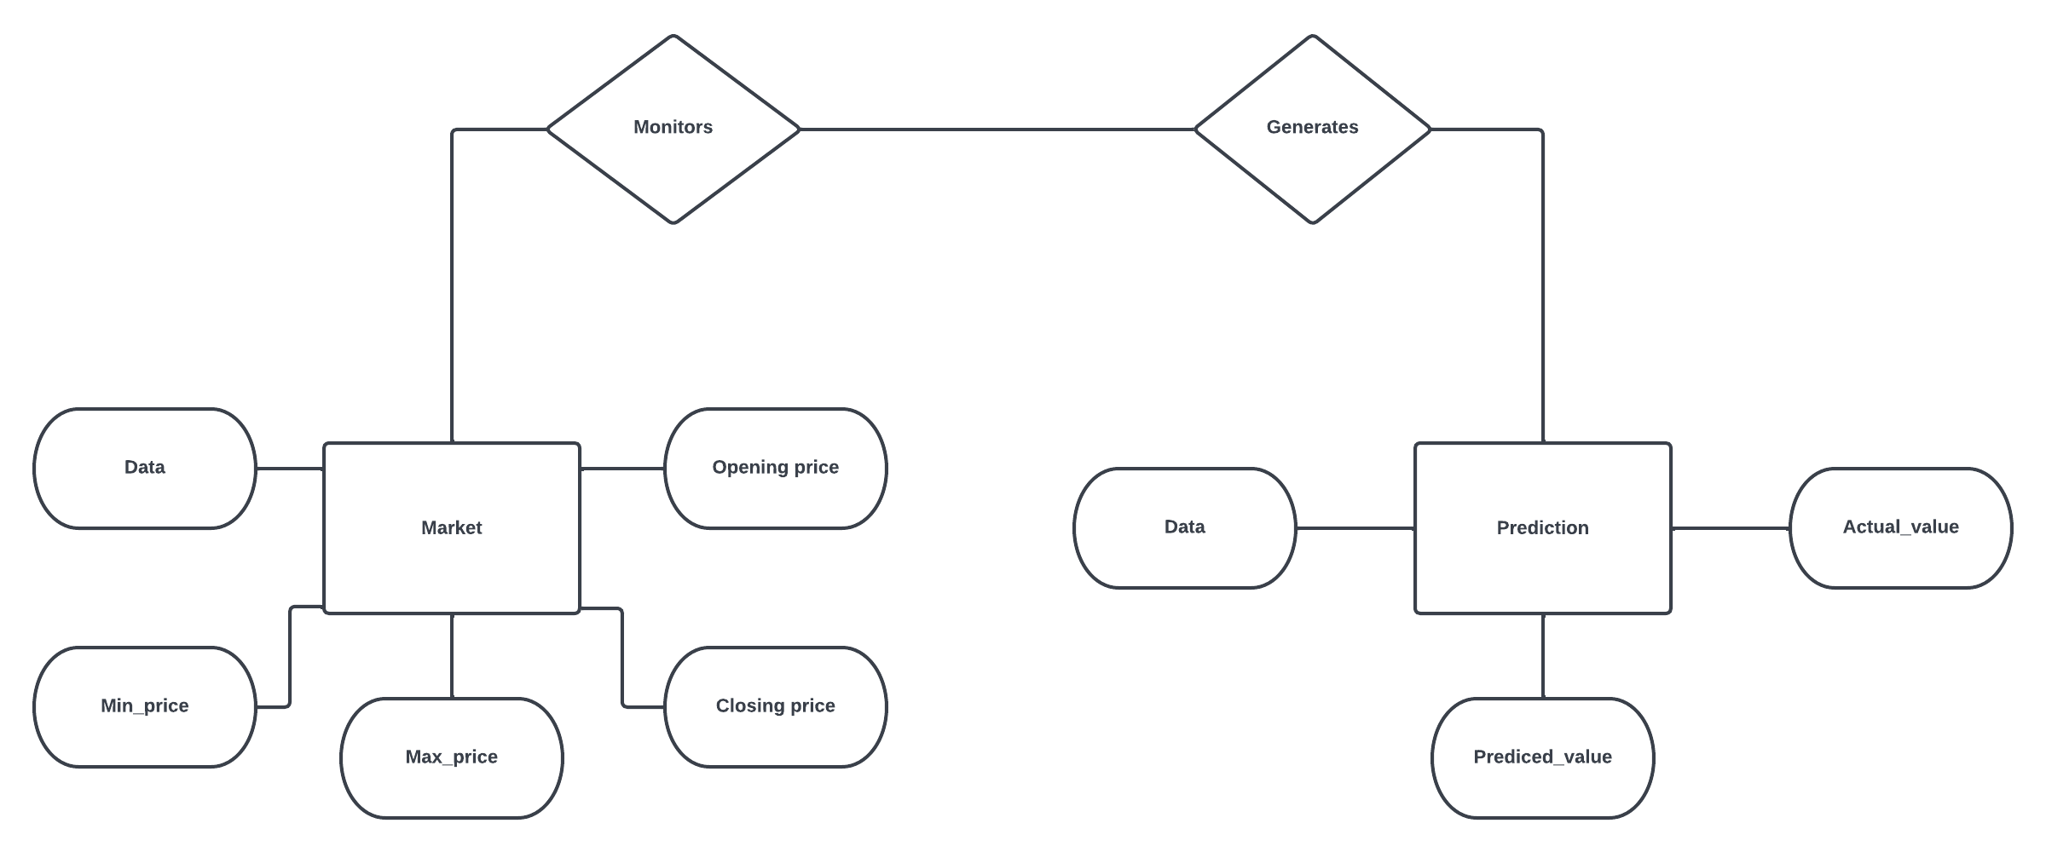
DESIGN
ER DIAGRAM

Slide 6
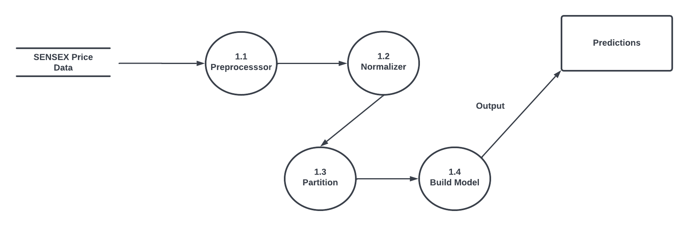
DESIGN
DFD DIAGRAM

Slide 7
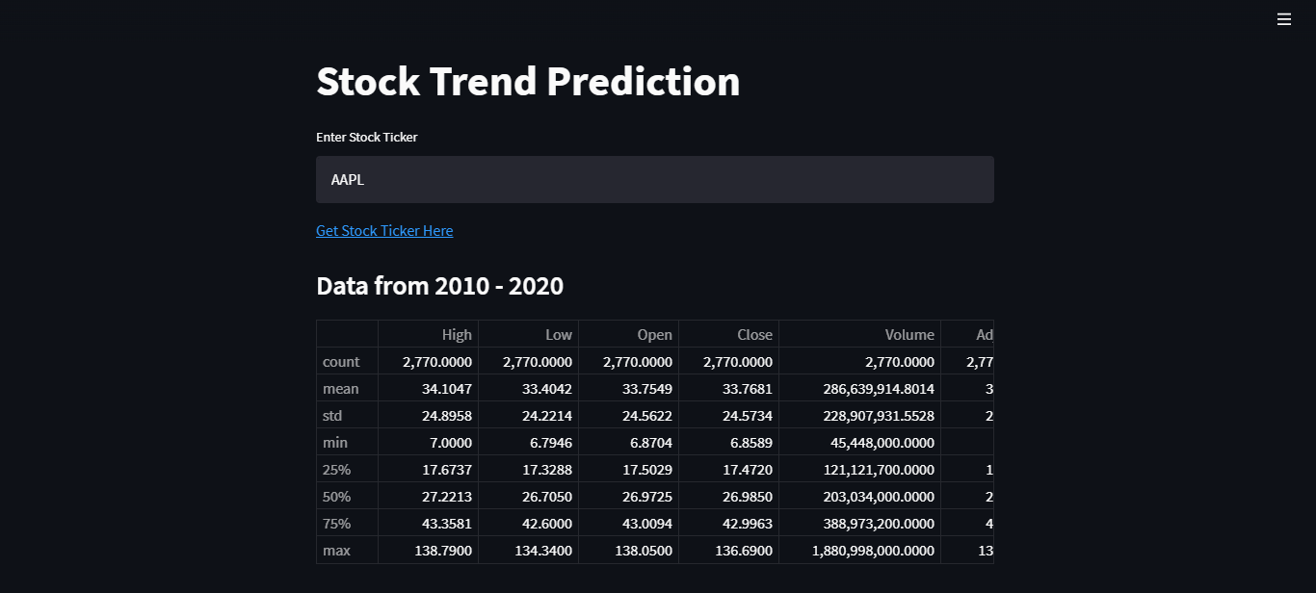
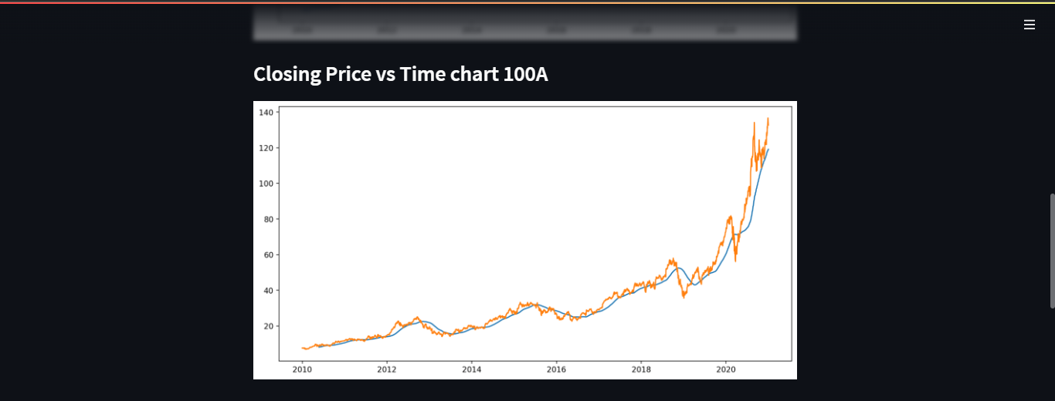
Screenshots

Slide 8

Outcome
Stock Price Prediction using machine learning helps you discover the future value of company stock and other financial assets traded on an exchange
The entire idea of predicting stock prices is to gain significant profits

